Slide 1
What is a “Lift?”
A Lift is a device for grabbing and moving objects in a predominately vertical direction

Slide 2
What is an “Arm”?
An “Arm” is a device for grabbing and moving objects using members that rotate about their ends

Slide 3
Relative Advantages of Lifts Over Arms
Usually simple to construct
Easy to control (don’t even need limit switches)
Maintain CG in a fixed XY location
Don’t Require Complex Gear Trains

Slide 4
Relative Advantages of Arms Over Lifts
Very Flexible
Can Right a Flipped Robot
Can Place Object in an Infinite Number of Positions Within Reach
Minimal Z - Great for going under things

Slide 5
Types of Lifts
Elevator
Forklift
Four Bar
Scissors

Slide 6
Elevator

Slide 7
Elevator - Advantages & Disadvantages
Advantages
  Simplest Structure
  On/Off Control
  VERY Rigid
  Can be Actuated via Screw, Cable, or Pnuematics
Disadvantages
  Lift Distance Limited to Max Robot Height
  Can’t Go Under Obstacles Lower Than Max Lift

Slide 8
Elevator - Design Considerations
Should be powered down as well as up
Slider needs to move freely
Need to be able to adjust cable length. A turnbuckle works great
Cable can be a loop
Drum needs 3-5 turns of excess cable
Keep cables or other actuators well protected

Slide 9
Elevator - Calculations
Fobject = Weight of Object + Weight of Slider
Dobject = Distance of Object CG
Tcable = Fobject
Mslider = Fobject• Dobject
Fslider1 = - Fslider2 = Mslider / 2Dslider
Fpulley = 2 Tcable
Fhit = (Weight of Object + Weight of Slider) • G value [I use .5]
Mhit = Fhit • Hslider
Mbase = Mslider + Mhit
Fpulley
Mslider
Fobject
Fslider1
Fhit
Dobject
Dslider
Fslider2
Tcable
Hslider
Mbase

Slide 10
Forklift

Slide 11
Forklift - Advantages & Disadvantages
Advantages
  Can reach higher than you want to go
  On/Off Control
  Can be rigid
  Can be Actuated via Screw, Cable, or Pnuematics, though all involve some cabling
Disadvantages
  Stability issues at extreme heights
  Can’t Go Under Obstacles Lower Than Retracted Lift

Slide 12
Forklift - Design Considerations
Should be powered down as well as up
Segments need to move freely
Need to be able to adjust cable length(s).
Two different ways to rig (see later slide)
MINIMIZE SLOP
Maximize segment overlap
Stiffness is as important as strength
Minimize weight, especially at the top

Slide 13
Forklift - Calculations
Mslider
Fobject
Fslider1
Fhit
Dobject
Dslider
Fobject = Weight of Object + Weight of Slider
Dobject = Distance of Object CG
Mslider = Fobject• Dobject
Fslider1 = - Fslider2 = Mslider / 2Dslider
Fhit = G value [I use .5] • (Weight of Object + Weight of Slider)
Mhitlower = Fhit•Hlower + [(Weight of Upper + Weight of Lower) • (Hlower / 2)]
Flower1 = - Flower2 = [Mslider + Mhitlower] / 2Dslider
Mhit = Fhit • Hslider + [(Weight of Lift • G value • Hslider ) / 2]
Mbase = Mslider + Mhit
Fslider2
Hupper
Fupper1
Hlower
Dupper
Dupper/2
Fupper2
Hslider
Flower1
Mlower
Dlower
Dlower/2
Flower2
Mbase

Slide 14
Forklift - Rigging
Continuos
Cascade

Slide 15
Forklift - Rigging -Continuos
Cable Goes Same Speed for Up and Down
Intermediate Sections Often Jam
Lowest Cable Tension
Tcable = Weight of Object + Weight of Lift Components Supported by Cable

Slide 16

Forklift - Rigging - Cascade
Upgoing and Downgoing Cables Have Different Speeds
Intermediate Sections Don’t Jam
Very Fast
Tcable3 = Weight of Object + Weight of Slider
Tcable2 = 2Tcable3 + Weight of Stage2
Tcable1 = 2Tcable2 + Weight of Stage1
Where n = number of moving stages
Different Cable Speeds Can be Handled with Different Drum Diameters or Multiple Pulleys
Tcable3
Slider
(Stage3)
Tcable2
Stage2
Stage1
Tcable1
Base

Slide 17
Four Bar

Slide 18
Four Bar - Advantages & Disadvantages
Advantages
  Great For Fixed Heights
  On/Off Control
  Lift Can Be Counter-Balanced or Spring Loaded to Reduce the Load on Actuator
  Good candidate for Pnuematic or Screw actuation
Disadvantages
  Need Clearance in Front During Lift
  Can’t Go Under Obstacles Lower Than Retracted Lift
  Got to Watch CG
  If Pnuematic, only two positions, Up and Down

Slide 19
Four Bar - Design Considerations
Pin Loadings can be very high
Watch for buckling in lower member
Counterbalance if you can
Keep CG aft

Slide 20
Four Bar - Calculations
Mgripper
Fobject
Fhit
Dobject
Dgripper
Fgripper1
Under Construction Check Back Later
Llink
Fgripper2
Flink1
Dlink
Flink2
Mlink
Hgripper
Dlower/2
Mbase

Slide 21
Scissors

Slide 22
Scissors - Advantages & Disadvantages
Advantages
  Minimum retracted height
Disadvantages
  Tends to be heavy
  High CG
  Doesn’t deal well with side loads
  Must be built precisely

Slide 23
Scissors - Design Considerations
Do You Really Want to Do This?
Members Must Be Good in Bending and Torsion
Joints Must Only Move in One Direction
The greater the separation between pivot and actuator line of action the lower the initial load on actuator
Best if it is directly under load

Slide 24
Scissors - Calculations
I don’t want to go there

Slide 25
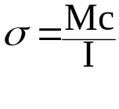
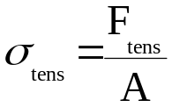
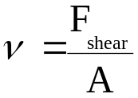
Stress Calculations
It all boils down to 3 equations:
Bending
Tensile
Shear
Where:
σ = Bending Stress
M = Moment (calculated earlier)
I = Moment of Inertia of Section
c = distance from Central Axis
Where:
σ = Tensile Stress
Ftens = Tensile Force
A = Area of Section
Where:
ν = Shear Stress
Fshear = Shear Force
A = Area of Section

Slide 26

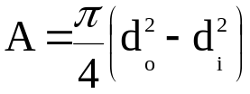
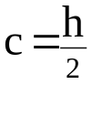
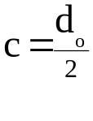
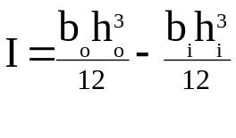
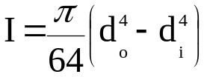
Stress Calculations (cont.)
A, c and I for Rectangular and Circular Sections
bo
do
bi
ho
di
c
hi

Slide 27

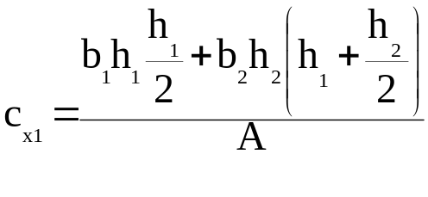
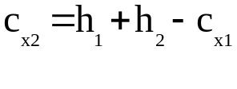
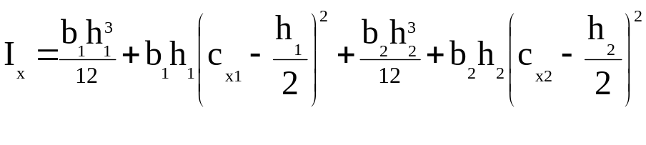
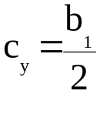
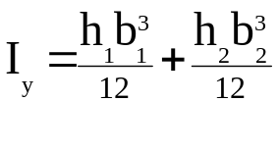
Stress Calculations (cont.)
A, c and I for T-Sections
Y
cy
h1
b1
cx1
X
h2
cx2
b2

Slide 28

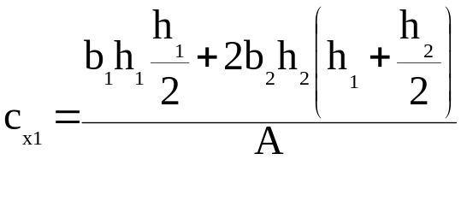
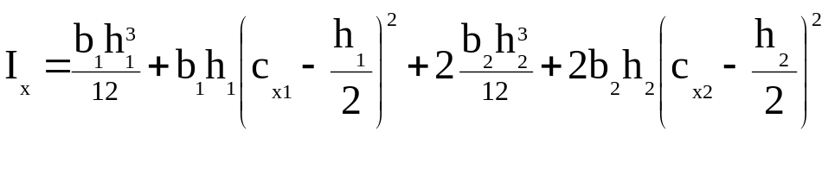
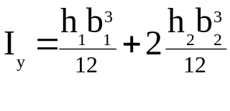
Stress Calculations (cont.)
A, c and I for C-Sections (Assumes Equal Legs)
Y
cy
h1
b1
cx1
X
h2
cx2
b2

Slide 29

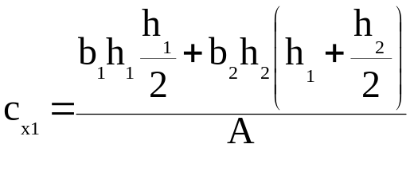
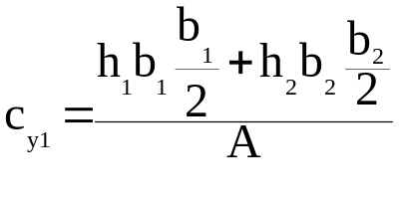
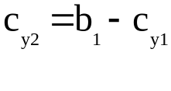
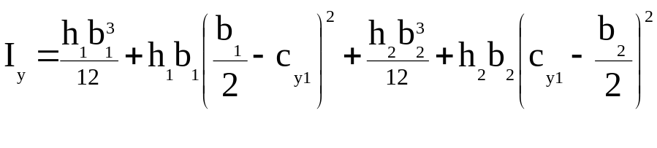
Stress Calculations (cont.)
A, c and I for L-Angles
Y
cy1
cy2
h1
b1
cx1
X
h2
cx2
b2

Slide 30
Allowable Stresses
σallowable = σyeild / Safety Factor
For the FIRST competition I use a Static Safety Factor of 4.
While on the high side it allows for unknowns and dynamic loads
Haven’t had anything break yet!

Slide 31
Allowable Stresses
Here are some properties for typical robot materials
Material Desig Temper Yield Tensile Shear Modulus
(ksi) (ksi) (ksi) (msi)
Alum 6061 O 8 18 12 10
Alum 6061 T6 40 45 30 10
Brass C36000 18-45 49-68 30-38 14
Copper C17000 135-165? 165-200? 19
Mild Steel 1015-22 HR 48 65 30
PVC Rigid 6-8 0.3-1

